Slide 1
Reels Research
For Kids Cancer Alliance

Slide 2
What are reels
Reels are 15-, 30-, or 60-second videos that can be created however the creator prefers.
They can be combined with music, themes, or other elements to engage viewers in more creative ways than just a plain image.
They can be used to bring attention to an issue, advertise, show off work, or just have fun.

Slide 3
Benefits of Reels
Reels are more likely to show up on the Instagram explore page, which means more than just your followers will have the opportunity to see the reels (based on their algorithm) and thus further explore your Instagram profile.
The creative process is entirely up to the maker, and there are plenty of tools to use and combine to make something entirely unique.
For beginners, there are also templates you can explore and use.
Content can be as simple or as complex as the creator wishes.

Slide 4
Benefits of reels continued
Reels are similar to TikTok in that they are short and use music or extended audio clips to interest viewers.
Beyond that, they engage the diverse age group present on Instagram instead of having to use another app like TikTok to make the videos.
This means younger viewers can engage with content in a format they are accustomed to and older viewers do not have to navigate the noise of a new platform to see the longer videos.

Slide 5
Instagram Algorithm
Relevance of the content
If a user liked or engaged in some way with a reel or post in the past, Instagram takes note of the subject and tries to show similar content.
Timeliness
People want to see what’s new.
Popularity
If the reels are receiving likes, being shared and getting audiences to engage, Instagram will see that as something special that other people might like, too, thus boosting it to the explore page.

Slide 6
Best time to post a reel
Sun | Mon | Tues | Wed | Thu | Fri | Sat
7am | 7am | 3am | 8am | 10am | 5am | 11am
8am | 11am | 5am | 9am | 1pm | 1pm | 6pm
4pm | 11pm | 10am | 12pm | 8pm | 3pm | 8pm
**These are just some generalized suggestions. The best time for Kids Cancer Alliance to post is entirely up to how your followers commonly interact with your page based on the time spent on the page, the time they log on, and how often you post.**

Slide 7
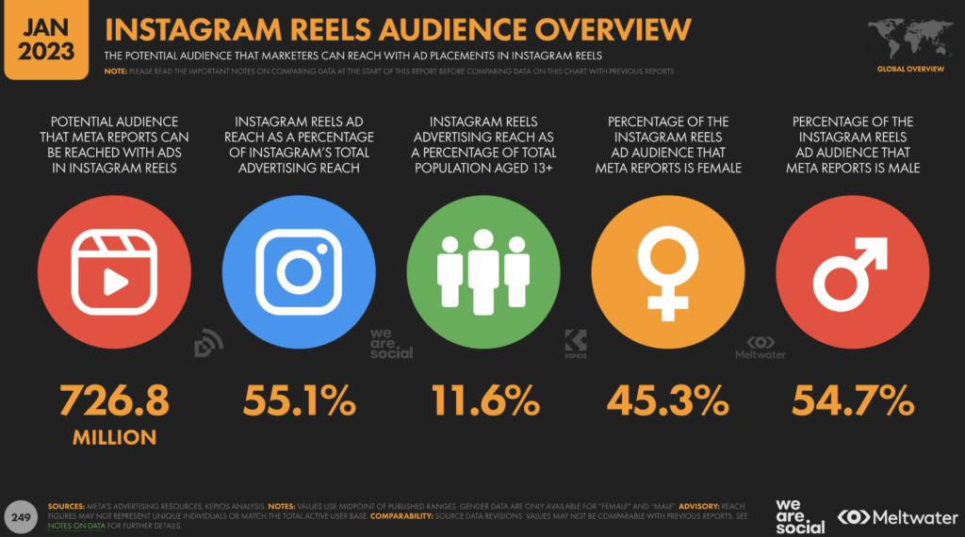
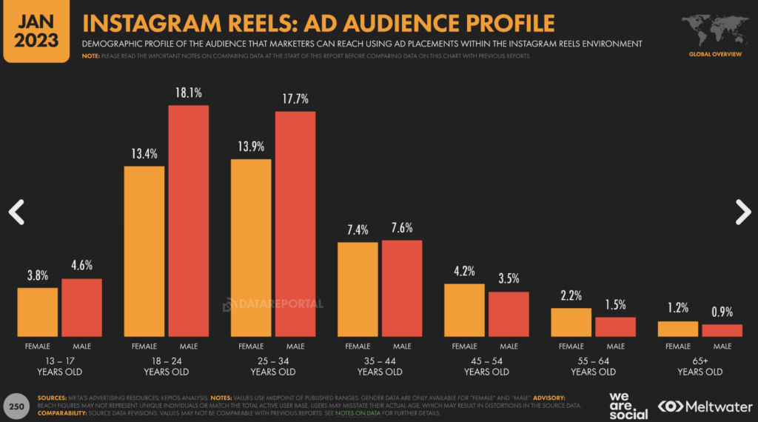
Reel Statistics

Slide 8
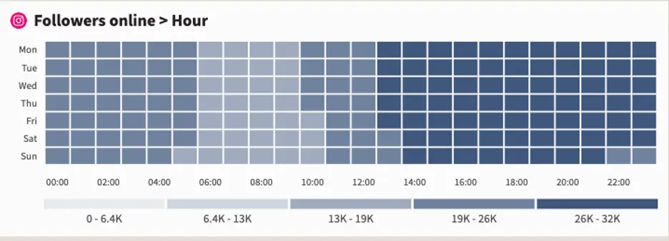
Example: 24 hour engagement of a page
https://blog.hootsuite.com/best-time-to-post-on-instagram/#Overall_best_time_to_post_on_Instagram_for_likes_comments_and_shares

Slide 9
Tips for working with the Instagram Algorithm
Post reels that are entertaining and fun:
Grab the audience's attention with comedy and have a fun twist.
Inspire (starting or following a trend)
Use vertical videos
Use trendy music
Use the right hashtag
Feature people in reels
Avoid reels with blurry content, watermarks from other platforms and covering the visual content.

Slide 10
Helpful Links

Slide 11
Helpful Link #1
Details what reels are and how they reach their audience and provides a traffic outlook from a creator standpoint.
Also reviews how the Instagram algorithm puts reels on the explore page so those beyond a page’s standard following have a chance to see them.

Slide 12
Helpful Link #2
Gives the basic steps for making a reel.
Gives 10 strategies for increasing a page’s traffic and growing your Instagram page.
Concludes with an FAQ about reels.

Slide 13
Helpful Link #3
This link will be your best friend when creating reels because it is the direct link to Instagram’s help center page about reels.
It reviews:
Recording and editing
Managing and sharing reels
Discovering reels
Reporting reels (that violate Instagram guidelines)

